Slide 1
Comments on TII responses
An Bord Pleanála Oral Hearing
MetroLink Railway Order

Slide 3
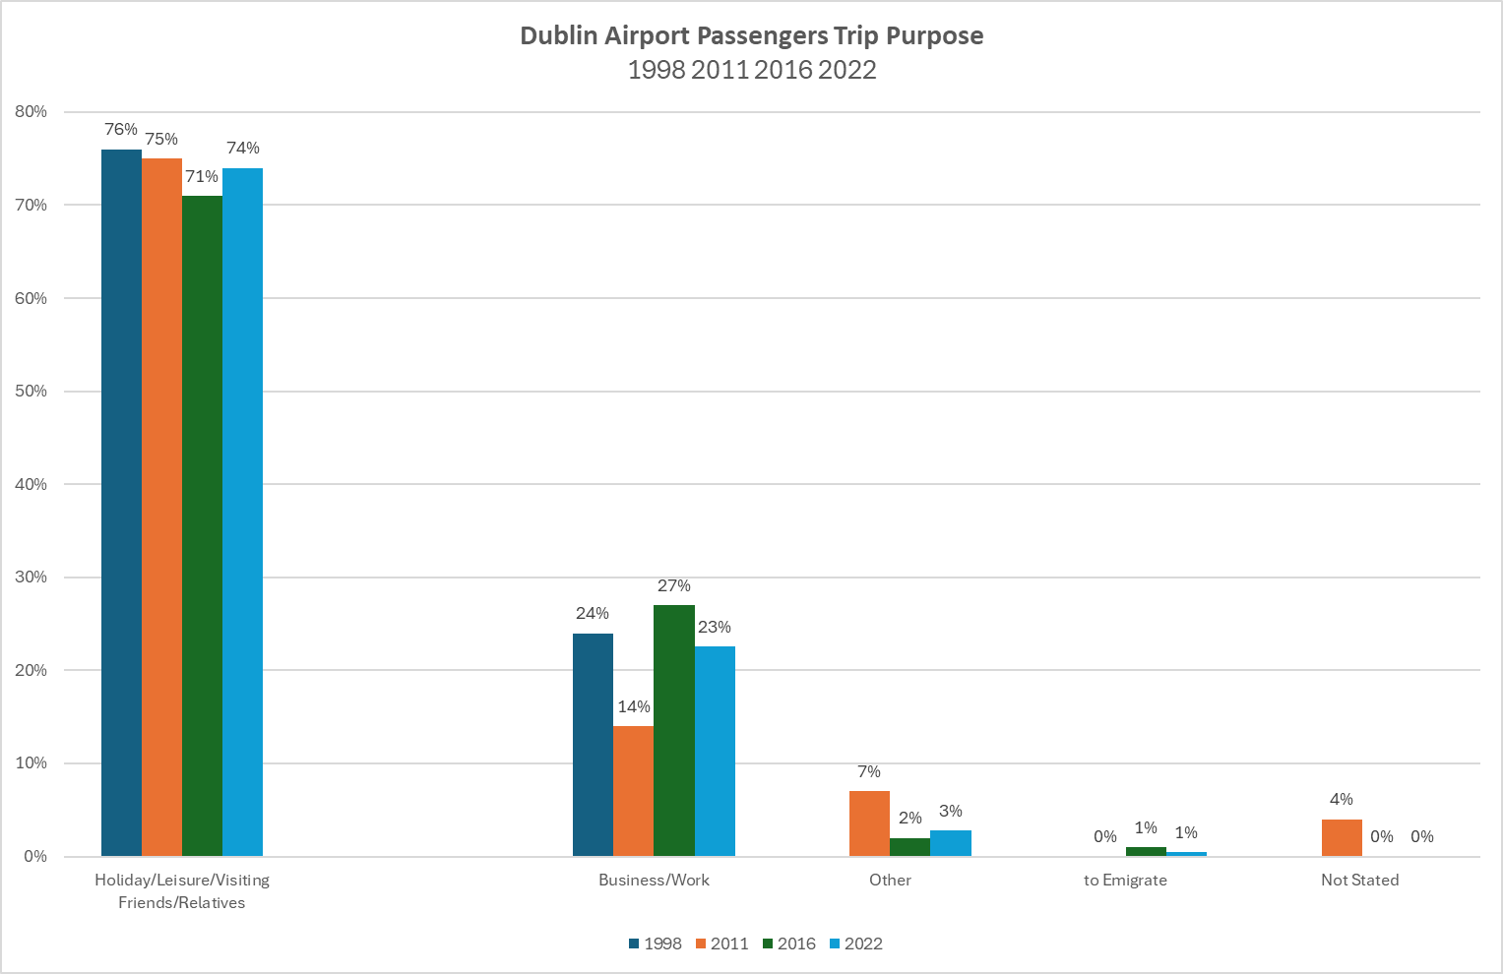

Slide 4
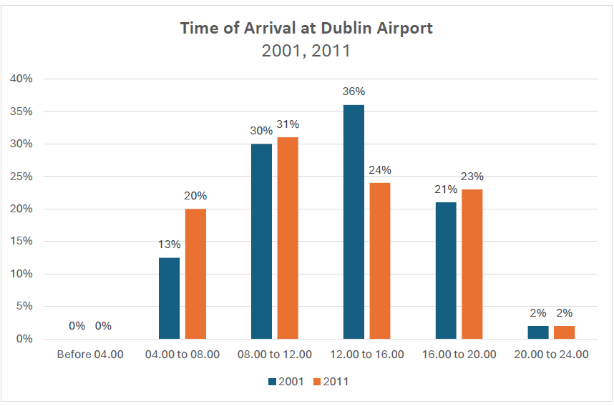

Slide 5
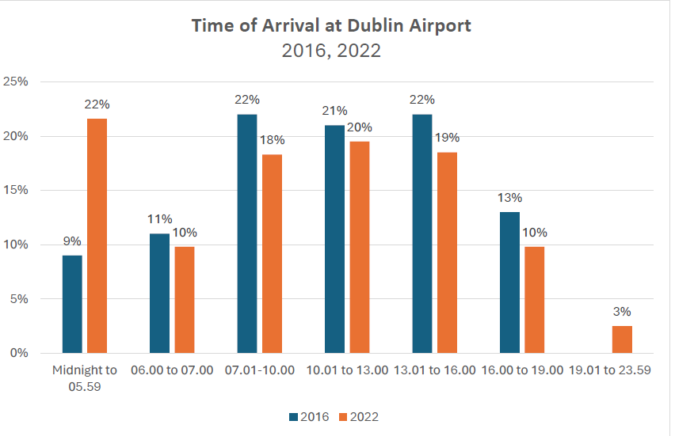

Slide 6
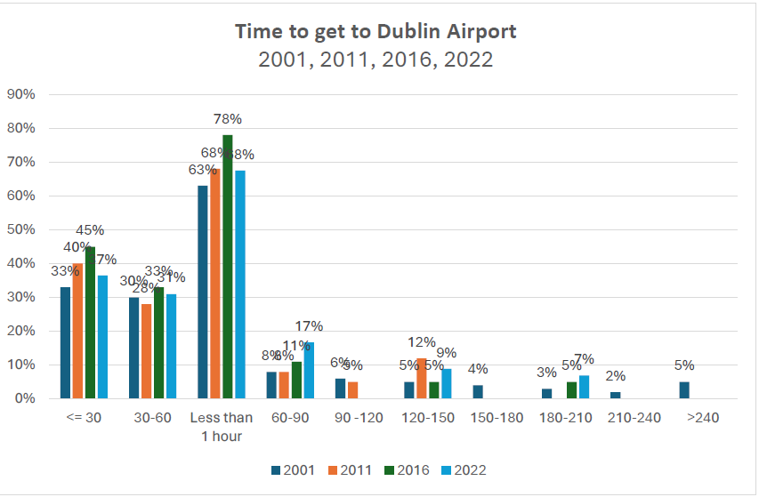

Slide 7
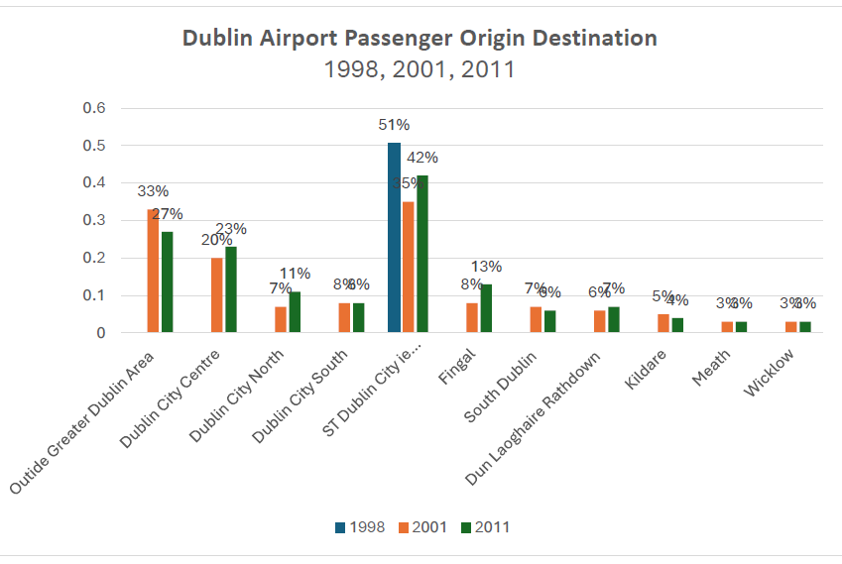

Slide 8
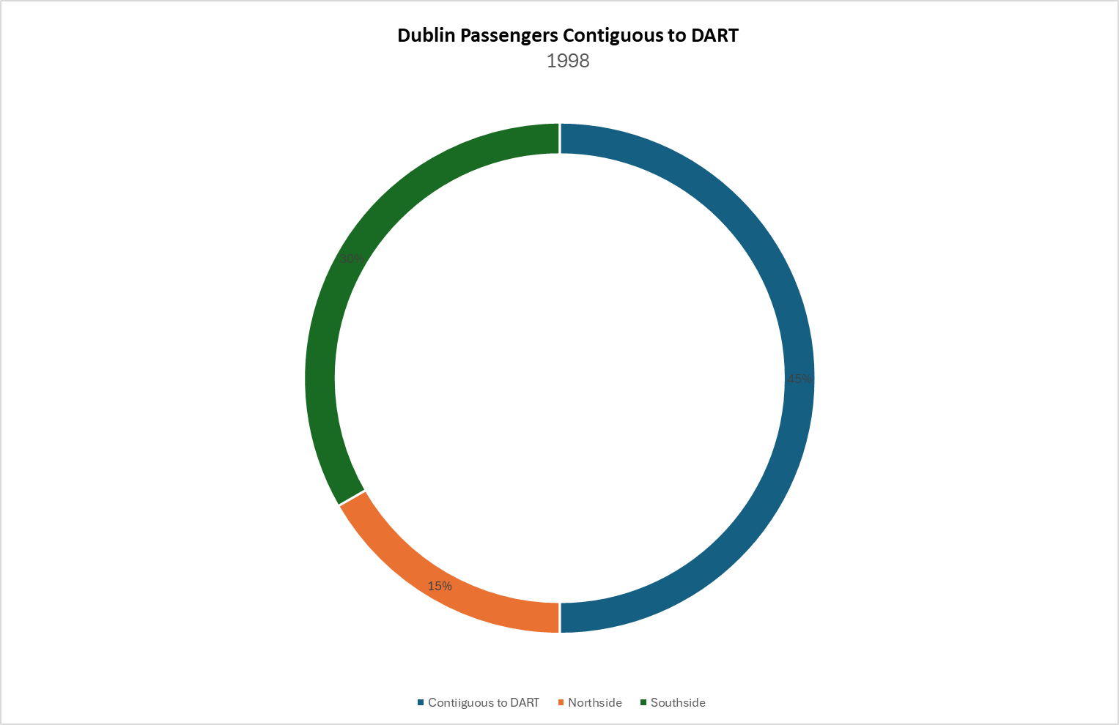

Slide 9
Major Projects Advisory Group
Review 2022

Slide 11
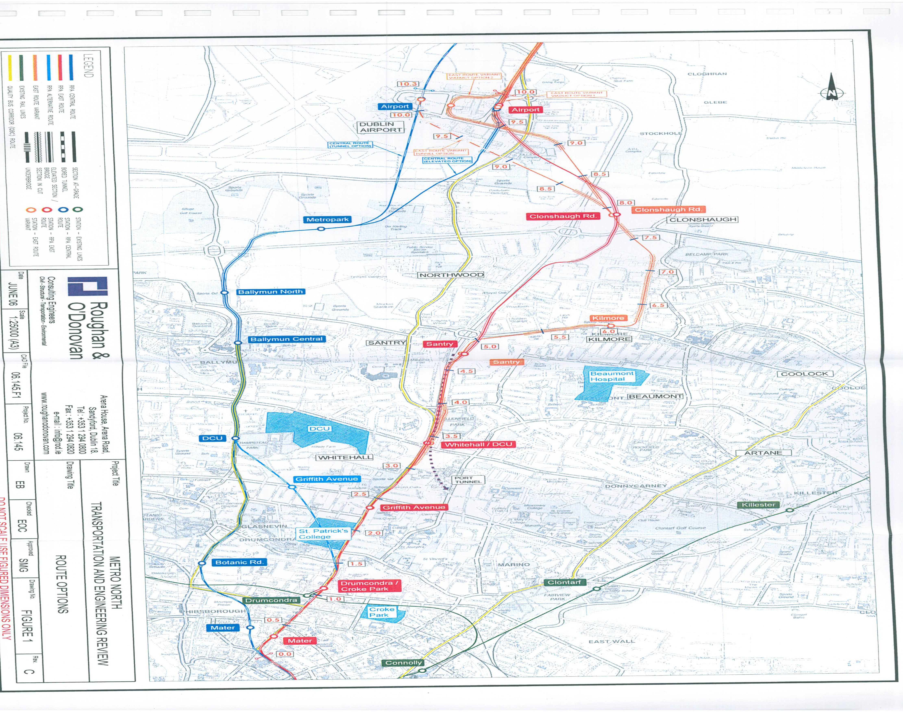
Eastern Variation Route
Roughan & O’Donovan 2006
Transportation and Engineering Review
Final Revision
June 2006

Slide 16
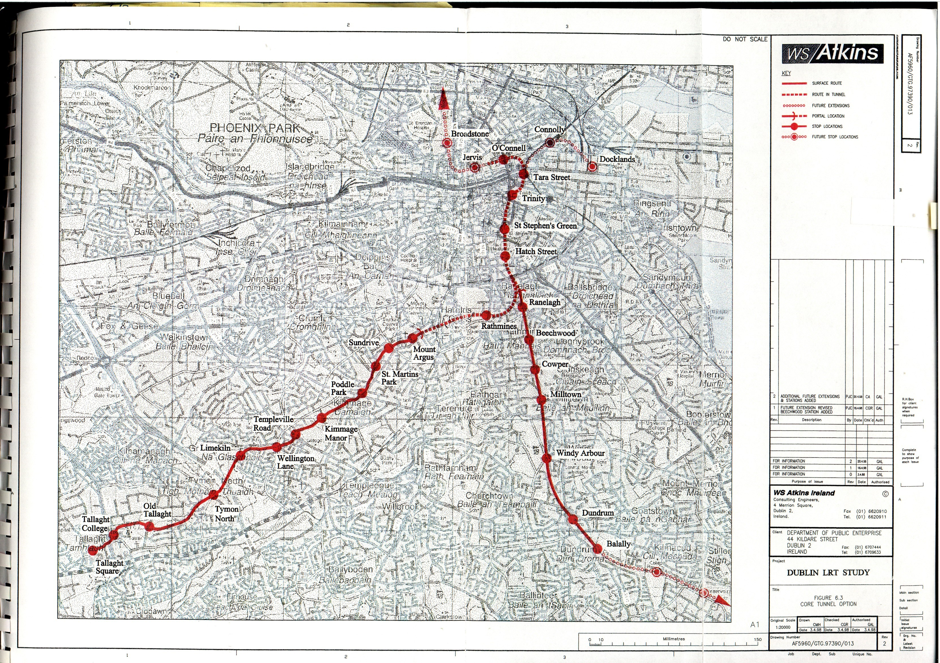
Core Tunnel Option
Atkins 1998

Slide 17
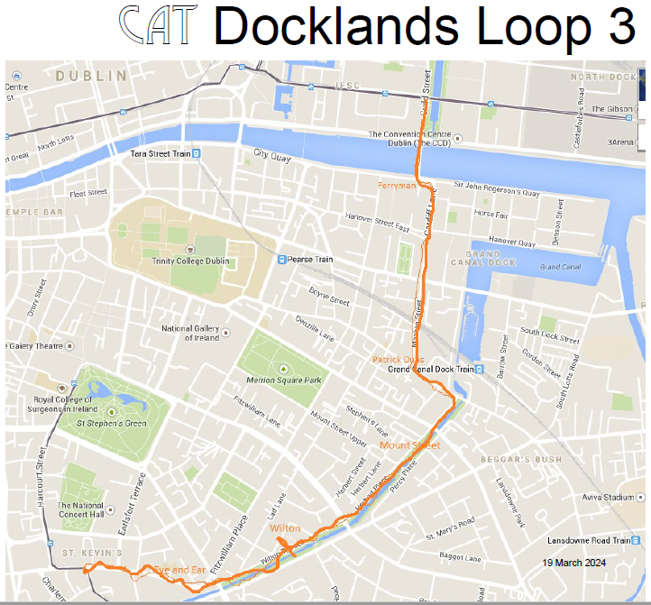

Slide 25
3.12 LR8. City Access Transit (CAT)
3.12.1 Scheme promoter or developer
This scheme was proposed by Drumcondra 2005, an amalgamation of Residents Associations
from the Drumcondra, Dublin 9 area. It was proposed as an alternative to the Metro North
Scheme which was to run further west of Drumcondra which, in the Residents Association’s
view, was too expensive and was missing a significant catchment area. The route would serve
both the Airport and Swords and is therefore in line with the brief for the project.

Slide 26
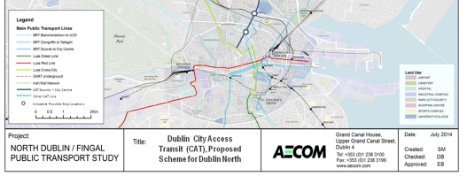

Slide 29
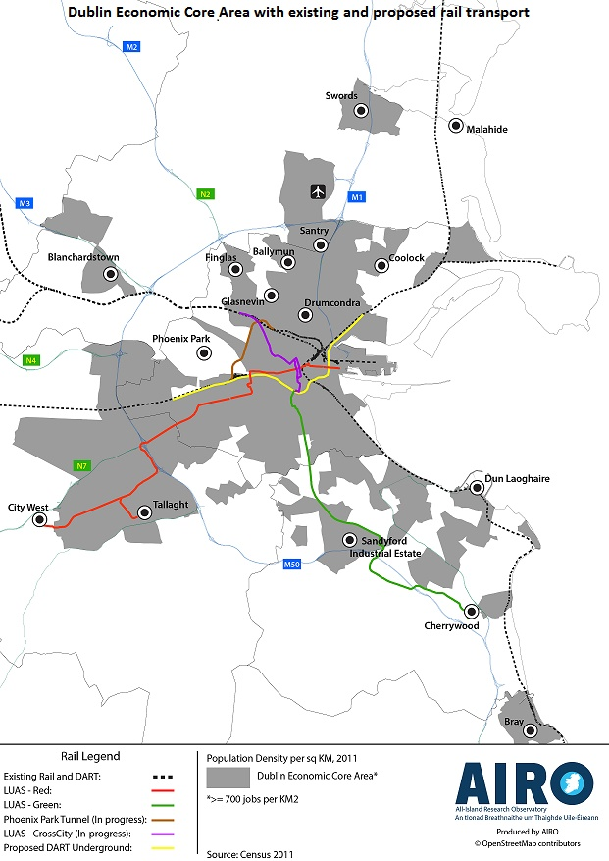

Slide 30
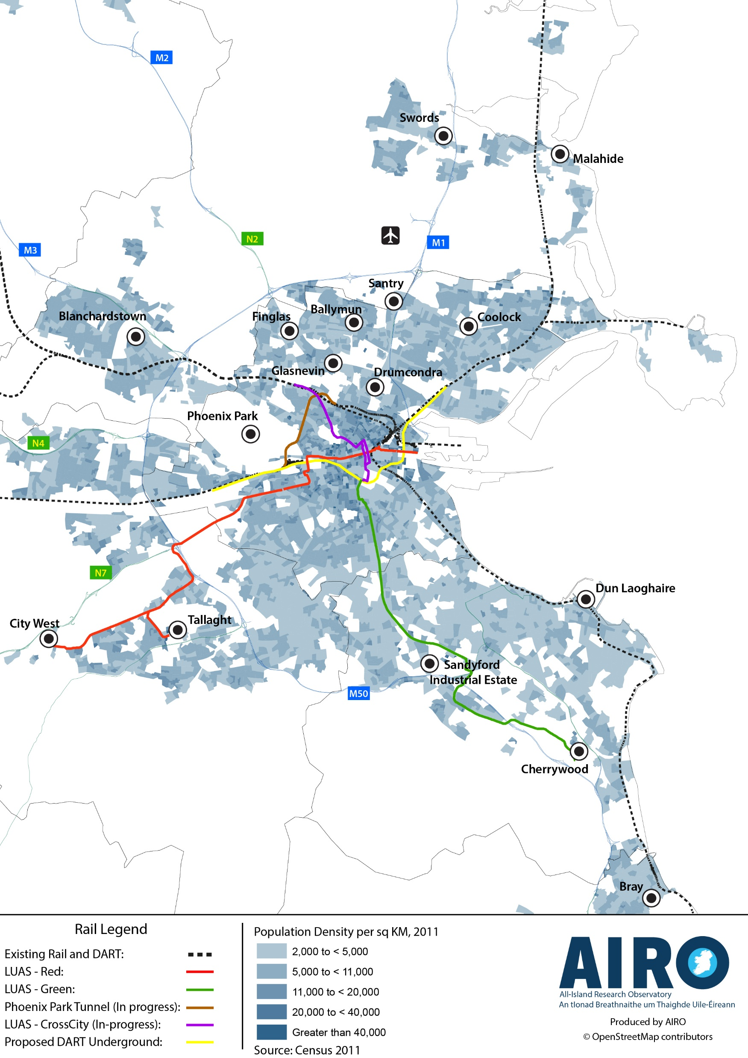

Slide 31
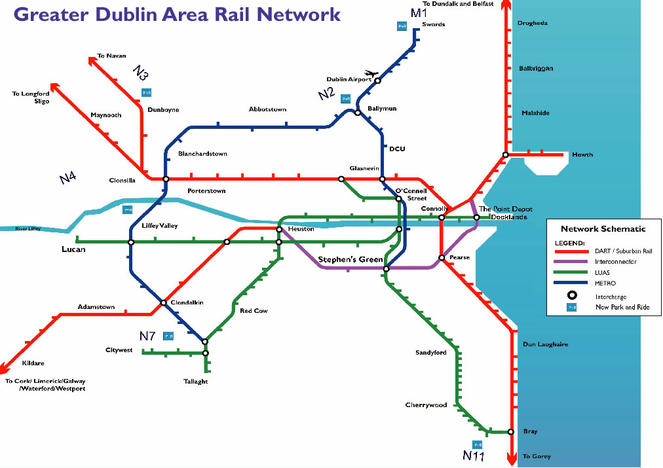
Transport 21 Dublin Rail Map

Slide 32
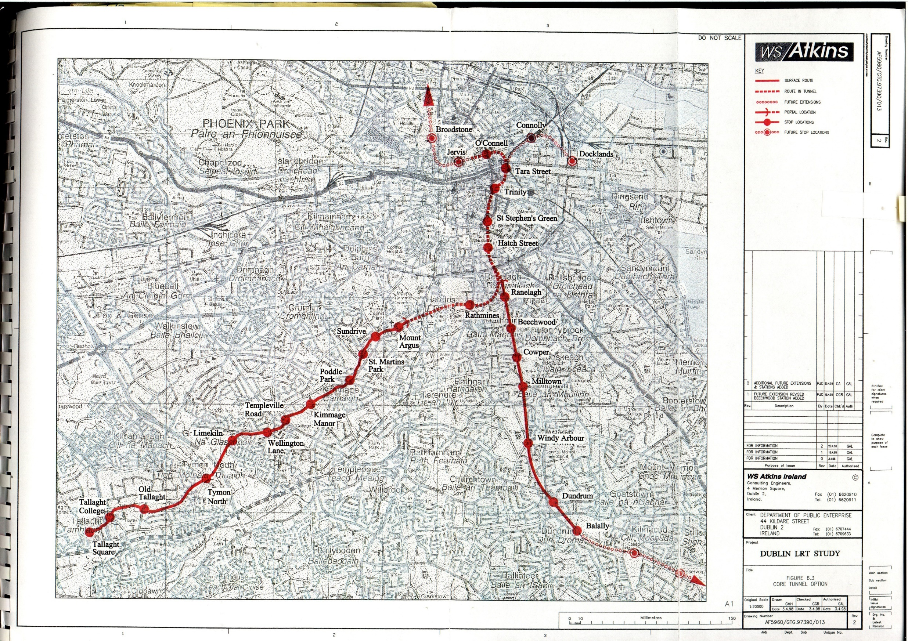
Core Tunnel Option 1998

Slide 35
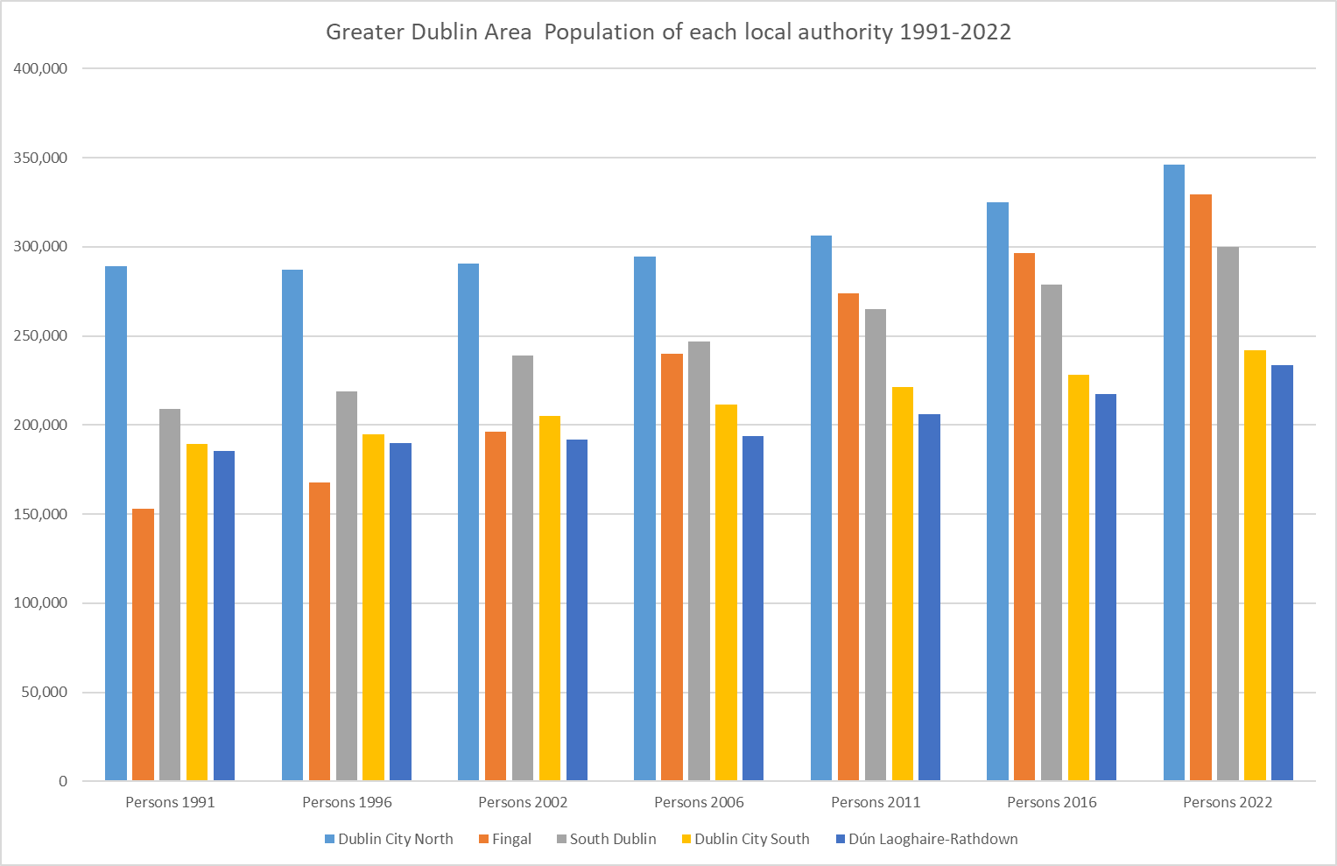

Slide 36
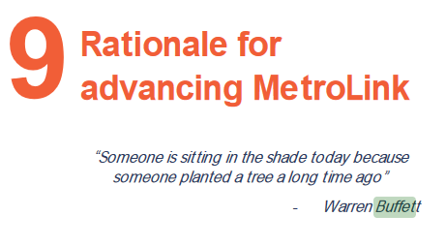

Slide 38
